Slide 1
Parallel Computing
Parallelization using Docker Containers
Anand Kadale
A HPC Future Application

Slide 2
01
Why
02
Benefits
Agenda
03
How
04
Future Scope

Slide 3
01 Why Docker

Slide 4
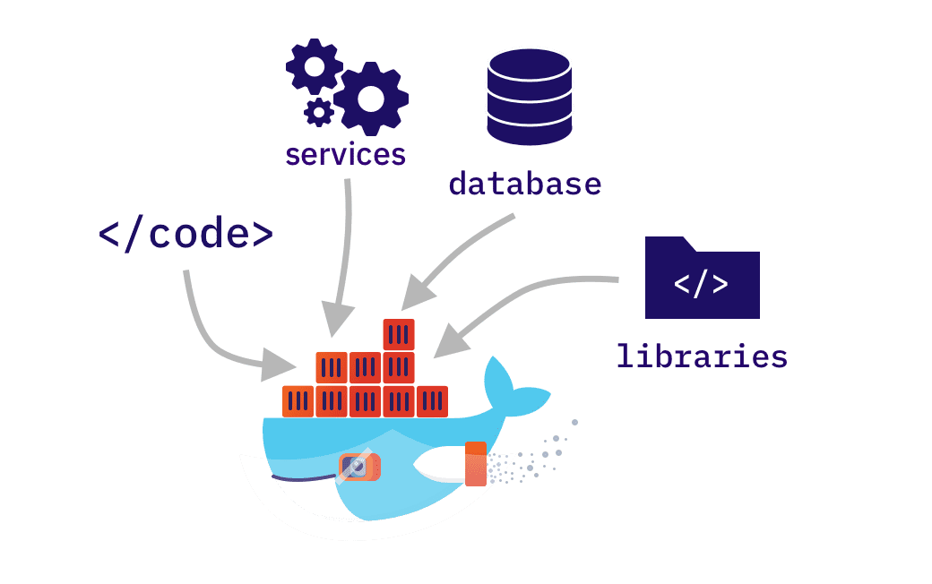
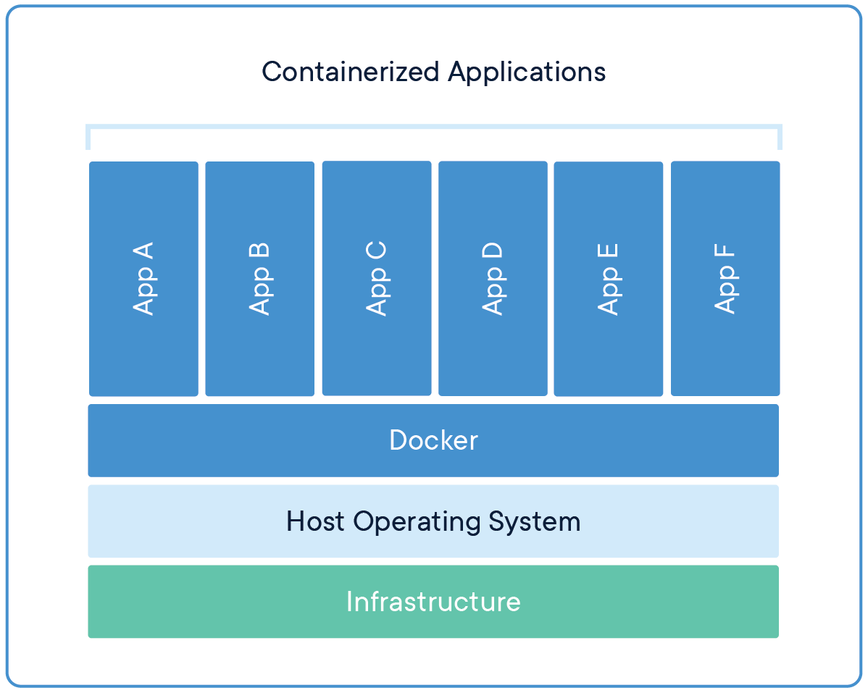
Docker is a containerization platform that provides a lightweight and portable way to package and deploy applications with their dependencies.
It enables you to create isolated environments that are consistent across different machines and operating systems, making it an excellent tool for parallelization and high-performance computing.

Slide 5
02 Benefits

Slide 6
Benefits NextGen HPC
01
02
03
04
Resource Management
Reproducability
Scalability
Flexibility
Docker enables efficient resource management and allocation, allowing parallel applications to run.
Docker provides a reproducible environment which is beneficial high-performance computing.
Docker enables distributed workloads to improve performance and reduce processing times.
Docker enables distributed workloads to improve performance and reduce processing times.

Slide 7
03 Demonstration

Slide 8
Future Scope
Executing process on cluster level
By this the process can be executed on physically separate clusters with help of kubernetes
HPC Using Containerization
01
02
Integration with Emerging Technologies
Docker's containerization platform will enable parallel computing in emerging technologies.
High Performance Computing
AI and Machine Learning
Docker simplifies AI and machine learning deployment, improving performance.
Parallel Computing
03
04
Multi-Cloud Environments
Organizations will benefit from Docker's multi-cloud capabilities.
Computing

Slide 9
Thank You
Anand Kadale

